Slide 1
E-Commerce With Dashboard
Project Title :- Shadow Store
Your Name :- [ Akhil Chaudhary ]
Uni. Roll No. :- [ 2115000106 ]
Department Name :- CEA Department

Slide 2
Introduction
In the dynamic landscape of e-commerce, understanding customer behavior and optimizing sales strategies are paramount for business success. As online retailers navigate through a plethora of data generated by transactions, customer interactions, and marketing efforts, the need for effective analytics tools becomes increasingly critical.
This introduction sets the stage for the development of an advanced E-commerce Analytics Dashboard, tailored to empower online retailers with actionable insights to drive growth, enhance customer satisfaction, and maximize revenue potential. By integrating with e-commerce platforms and leveraging comprehensive analytics, this dashboard aims to provide retailers with a holistic view of their business performance and customer engagement metrics.

Slide 3
Objectives
Optimizing sales Performance
Enhance Customer Segmentation
Maximize Product Performance
Reduce Cart Abandonment Rates
Foster Customer Retention
User-Friendly Interface
Improve Customer Satisfaction

Slide 4
Problem Statement
In the rapidly evolving landscape of e-commerce, online retailers face numerous challenges in effectively analyzing customer behavior, tracking sales performance, and optimizing marketing strategies. The absence of a comprehensive analytics solution often hinders retailers from harnessing valuable insights from transaction data to drive business growth and enhance customer satisfaction. As a result, there is a critical need for an advanced E-commerce Analytics Dashboard that integrates seamlessly with e-commerce platforms, collects transaction data, and generates actionable insights to address the following key challenge.

Slide 5
Literature Review
Overview of Existing Collaborative Platform
Limited Customization
Real-Time Insights
Lack of Predictive Analytics
User-Friendly Interface
Identified Gaps and Limitations
Simplicity : many targeted customers needed to have a clear understanding of what is trending in a simple way
Intuitive User Interface : a clear and cut interface that helps users in increasing productivity with advanced features and quick learning curve.

Slide 6
Methodology
Platform Architecture and Design:
The frontend of the platform is built using React.js, a JavaScript library for building user interfaces
React components are organized hierarchically to create a modular 2. Backend (Express.js):
The backend is developed using Express.js, a minimalist web framework for Node.js.
Express.js handles incoming HTTP requests, routes them to the appropriate handlers, and sends responses back to the client.
MongoDB, a NoSQL database, is used to store project details, user information, and collaborative data.
Collections are designed to efficiently store and query data related to users and products.
Authentication is employed for secure user authentication and authorization.
JWT (JSON Web Tokens) are generated upon successful authentication and used to verify user identity for subsequent requests.

Slide 7
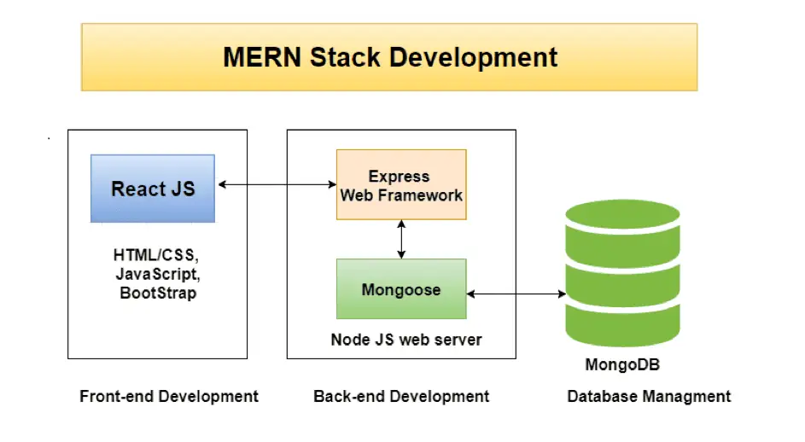
System Architecture

Slide 8
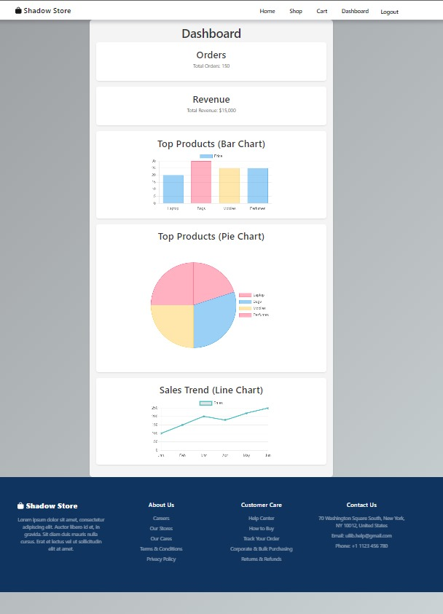
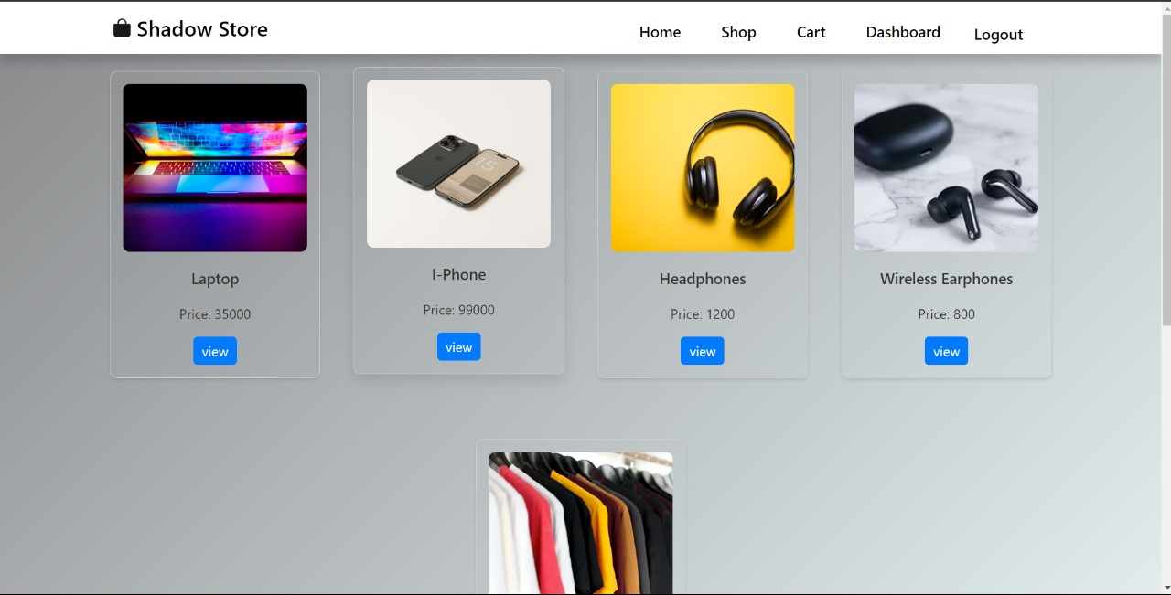
Implementation

Slide 9
Features
1. Product Dashboard:
Description: A dedicated space for sellers to analyse their products.
Unique Functionality: The platform categorizes projects based on disciplines, themes, and sellers, allowing for easy exploration and recognition.
2. Product Analysis Features:
Description: Analysis of products which provides detailed information on multiples products sellers sells.
3. User-Friendly Interface:
Description: An intuitive and easy-to-navigate user interface.
Unique Functionality: The design is user-centric, ensuring accessibility for businesses with varying technical proficiencies.

Slide 10
Results
Productivity and Product Analysis made easy
User Satisfaction
Better Interactivity for sellers

Slide 11
Challenges Faced
Ensuring Data Security and Privacy:
Challenge: Handling sensitive student data while ensuring security and privacy.
Solution: Implement robust encryption protocols, adhere to industry-standard security practices, and comply with data protection regulations. Conduct regular security audits and penetration testing to identify and address vulnerabilities.
Technical Proficiency of Users:
Challenge: Students may have varying levels of technical proficiency, impacting their ability to navigate and utilize the platform.
Solution: Design an intuitive user interface with clear instructions and tooltips. Provide onboarding resources and tutorials. Conduct user testing to gather feedback and make iterative improvements to enhance usability.

Slide 12
Future Work
Feature Enhancements
Advanced Analysis Tools
Review Analysis Building
Internationalization and Multilingual Support
Customer Retention Analysis

Slide 13
Conclusion
The platform's key features, such as product analysis , profile creation and real-time analysis, product selling features and
business development address the identified gaps in existing systems. By providing a space where sellers can explore and sell seamlessly, analysing their products.

Slide 14
Acknowledgments
We extend our sincere appreciation to Mr. Monu Kumar, our esteemed project mentor, whose unwavering encouragement, guidance, and assistance have been instrumental in the successful completion of this project. Additionally, we express our gratitude to our dedicated team members for their unwavering support, contributing significantly to the accurate and timely realization of the project objectives. This endeavor has not only augmented our technical proficiency but has also cultivated a heightened sense of maturity in thought and vision, qualities essential for professional growth. We are grateful for the invaluable insights gained from this experience under Mr. Monu Kumar mentorship and the collaborative efforts of our team members.

Slide 15
Q&A
Thank you everyone!

